Slide 1

G5T7
Beh Wei Chen Goh Soo Chi Lim Jia Yu Shermin Tan Wong Wei Ling
Notes:
Some notes about final presentation:
Presentation slides must be committed to Git before the the project deadline.
You must use the slides committed during presentation.
Everybody has to be present and punctual, and have to stay for the entire presentation slot
You are allowed to choose your presenters. However, all team members are strongly encouraged to present.

Slide 2
CONTENTS
-01-
-03-
SCHEDULE
USAGE OF GIT
-02-
-04-
BUG METRIC
TAKEAWAYS

Slide 3

SCHEDULE

Slide 4
ITERATION 1
16 Sep | 17 | 18 | 19 | 20 | 21 | 22 | 23 | 24 | 25 | 26 | 27 | 28 | 29 | 30 | 31 | 1 Oct | 2
2 | 1 |  | 2 |  | 1 | 2 | 2 | 2 | 1 |  |  | 1 | 2 | 3 |  | 2 | 3
1.75 | 2 |  |  | 3 |  | 4 | 2 | 2.5 | 1 |  |  | 1 | 2 |  |  | 3 | 3
(24) Planned
Actual
(25.25)
ITERATION 2
4 Oct | 5 | 6 | 7 | 8 | 9 | 10 | 11 | 12 | 13 | 14 | 15 | 16 | 17
2 | 4 | 6 |  |  | 6 |  |  | 10 | 2 | 5 |  | 3 | 4
2 | 4 | 6 |  | 3 | 4.5 |  |  | 8 | 3 | 5 |  | 3 | 4
(42)
Planned
Actual
(42.5)
Notes:
Visual representation of Actual Versus Planned Schedule in 2 or less readable slides. A timeline representation is sufficient here.

Slide 5
ITERATION 3
18 Oct | 19 | 20 | 21 | 22 | 23 | 24 | 25 | 26 | 27 | 28 | 29 | 30 | 31
2 |  | 3 | 2 | 1 |  | 4 |  | 3 | 2 | 2 | 3 | 2 | 4
2 |  |  | 5 | 2.5 |  | 1.5 | 4 |  |  | 9 | 3 | 2 | 4
(28)
Planned
Actual
(33)
ITERATION 4
1 Nov | 2 | 3 | 4 | 5 | 6 | 7 | 8 | 9 | 10 | 11 | 12 | 13 | 14 | 15 | 16 | 17
2 |  |  | 4 | 3 | 2 |  | 2 |  |  | 4 | 4 |  |  | 2 |  | 1
2 |  |  |  |  |  |  |  | 7 | 7 | 2 | 1 |  |  | 2 |  | 1
(24)
Planned
Actual
(22)
Notes:
Visual representation of Actual Versus Planned Schedule in 2 or less readable slides. A timeline representation is sufficient here.

Slide 6

FUNCTIONALITIES
DETAILS
No functionalities were dropped
Additional timetable functionality implemented
Some external libraries covered in class were used
JSON checker & web token
PHP data objects & file upload
ZipArchive extract
Notes:
Did you drop any functionalities, implement any additional functionalities, and/or use any frameworks or external libraries? If so what.

Slide 7
TASK ALLOCATION
ITER 1
Pair 1
Pair 1
Pair 2
Pair 2
(PM)
 | Geralyn | Wei Ling | Shermin | Wei Chen | Jia Yu
Database related
Authenticate
Bootstrap
Test cases
Testing
Debug
Bug Metric
3
3
2
2
4.5
4.5
5
5
2
2
1
1
1
1
1
1
Notes:
Show us your breakdown of work. Separate the programming tasks from the non-programming tasks. For programming tasks, show us the task allocation as well as the hours spent by each team member.

Slide 8
TASK ALLOCATION
ITER 2
Pair 1
Pair 2
(PM)
 | Geralyn | Wei Ling | Shermin | Jia Yu | Wei Chen
Place Bid
Drop Bid
Drop Section
Start Round
Clear Round(1)
Test cases
Testing
Debug
Bug Metric
Pair 3
2
2
4
4
3.5
3.5
3.5
3.5
2
2
2
2
5
5
3
3
3
1
1
1
2
2
1
1

Slide 9
TASK ALLOCATION
ITER 3
Pair 1
Pair 2
(PM)
 | Geralyn | Wei Ling | Wei Chen | Jia Yu | Shermin
Clear Round(2)
View Bidding
Start / Stop Round
Dumps & Bid Status
Test cases
Testing
Debug
Bug Metric
PM
3
3
2.5
2.5
1.5
1.5
4
4
4
4
4
4
4
1
1
2
2
1
1
1
1

Slide 10
TASK ALLOCATION
ITER 4
Pair 1
Pair 2
PM
(PM)
 | Geralyn | Jia Yu | Wei Chen | Shermin | Wei Ling
Test cases
Testing
Debug
Bug Metric
4
4
2
2
2
2
5
5
5
1
1

Slide 11
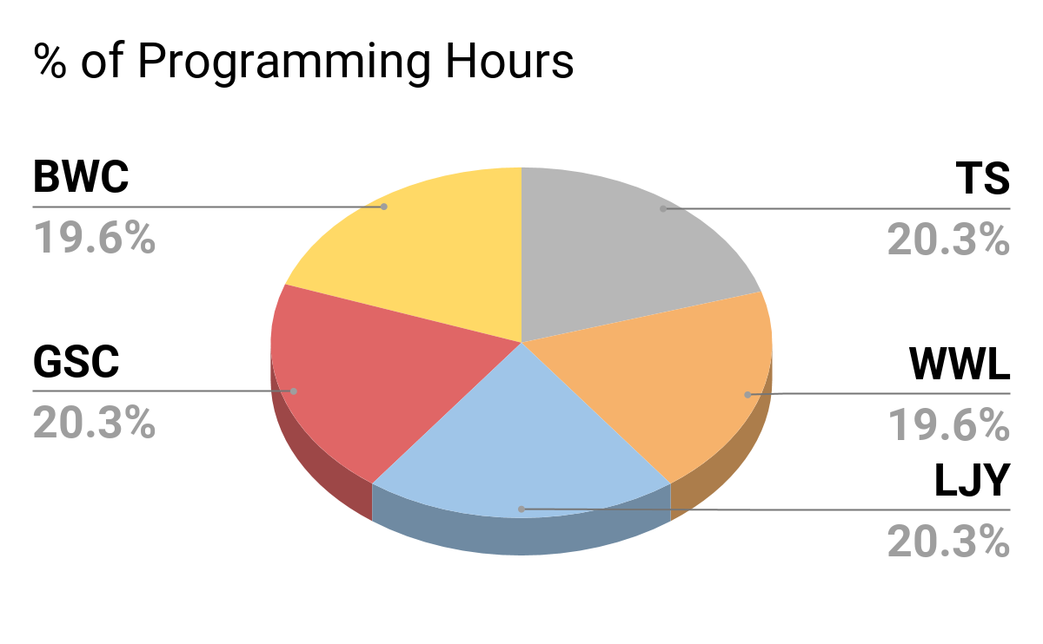
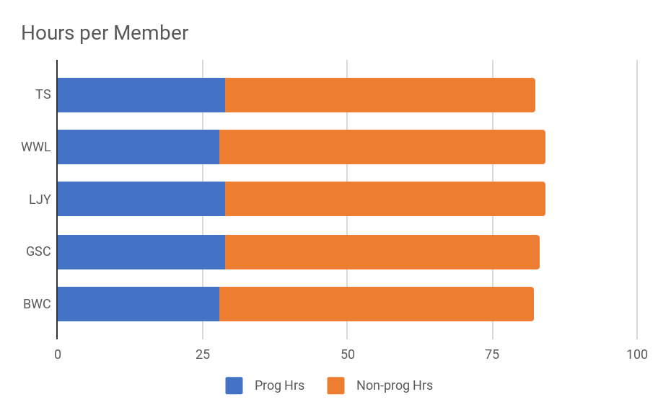
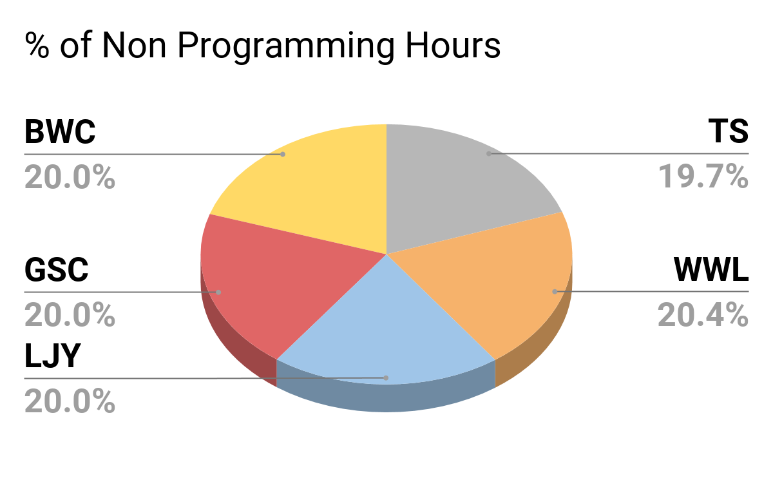
HOURS SPENT
28
29
29
28
29
53.5
29
28
56.25
29
55.25
29
54.25
28
54.25
54.25
53.5
54.25
56.25
55.25
Notes:
Explain why your work allocation was fair. Show us absolute numbers as well as percentages.

Slide 12
SCHEDULE
PROBLEMS
Keeping up with the schedule and requirement changes
Re-scheduling of tasks due to unforeseen changes
Inaccurate forum instructions
Additional bid status functionality
Members inactive for periods of time
Difficulty estimating effort required for task scheduled
Discrepancy between planned files and actual files created
Notes:
Tell us about the problems you faced tracking your schedule and how you overcame them.
Clear and open channels of communication
Setting of expectations (be committed, inform inactiveness in advance and be more involved upon return, help each other out during the respective busy periods)
For any changes, ensure the entire group is on the same page, overcome together (change is the only constant, must be quick to adapt and adjust schedule)

Slide 13

BUG METRICS

Slide 14
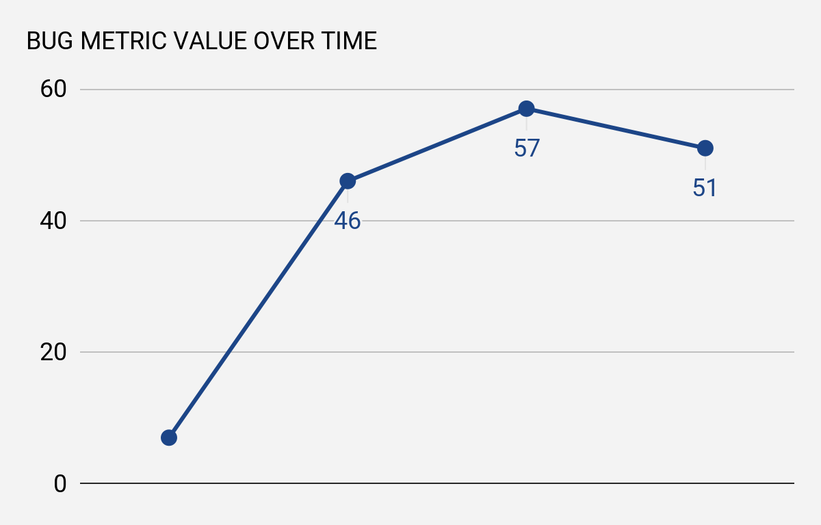
BUG METRIC
7
 | Iter 1 | Iter 2 | Iter 3 | Iter 4
Low Impact (1) | 2 | 1 | 2 | 1
High Impact (5) | 1 | 7 | 5 | 8
Critical Impact (10) | 0 | 1 | 3 | 1
Notes:
Show us a visual representation for the metric that shows the values of the metric over time.

Slide 15

BUG METRIC
FIXING PROBLEMS
Consolidation of all bugs found
Ensures all members are on the same page
Facilitate the allocation of debugging tasks
Additional layer of check for defective test cases
Identification of code segment throwing errors
Systematic solving of bugs (Critical -> Low)
Notes:
Tell us how you used the metric to fix problems identified.
Bug metric serve as a consolidation of all bugs found. Once it has been updated and pushed, all members can refer to it and be on the same page. It also gives PM an overview of all the bugs found, facilitating the allocation of debugging tasks.
Defective test cases can be discovered as well through the description.
PP teams who wrote the code can also understand the errors thrown and advise the debugging team on the code segments to focus on since they understand their own code best.
PP teams can also prioritise bugs with the highest impact during their debugging session

Slide 16





BUG METRIC
TACKLING BUGS
FINDING BUGS
RELAYED TO PM
GROUP NOTIFIED
DEBUGGING SESSION
RESOLVING OF BUGS
Discovery of bugs during testing,
Bug Metric updated
PM arranges schedule
Separate debugging session allocated
Clarify code with other pp team if necessary
Bug Metric updated, group & PM notified
Notes:
Give us examples of concrete follow-on actions you took to fix the most severe problems identified by the metric.
For our recent Iteration 4, we discovered a bug for our Clear Round function regarding undefined offset 0 during testing. It had critical impact because the error message thrown makes the system unusable. After the bug metric was updated, it was sent to the PM together with a list of other bugs found during testing. PM then allocated the debugging tasks to the pp teams and the debugging of this critical bug was assigned to Geralyn and Jia Yu. Usually the team who wrote the code would advise the debugging team on which code segment to focus on but in this case, since Jia Yu worked on the code together with Wei Chen, she was able to guide Geralyn and the bug was resolved. Turns out one of the empty arrays got its first index selected even though there wasn’t one. After the bug was resolved during the debugging, BM was updated and the PM was notified.

Slide 17



BUG METRIC
CHALLENGES
Unclear bug description in bug metric
Difficult to identify and debug errors in deployed app ...HTTP 500 error
Debugging team unsure of how to resolve code with bug
Inform and consult group for consistent description
Retrieve server error log and find solutions on Google
Clarify the code with the other pp team and request help if necessary
Notes:
What were some of the challenges faced (and how you overcame them) when collecting and using the metric?
500 Internal Server Error is a very general HTTP status code that means something has gone wrong on the web site's server but the server could not be more specific on what the exact problem is.

Slide 18
USAGE OF GIT
Notes:
Demonstrate to us that you used Git consistently, correctly, and evenly (across your entire team). You should use data (in nice graphical forms) from your commit logs, commit histories to substantiate your claims.

Slide 19
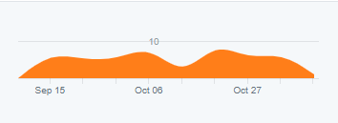
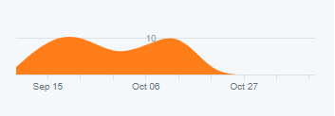
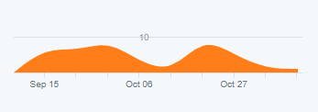
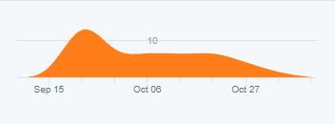
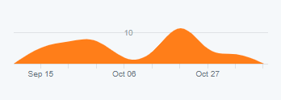
GIT HUB
CONSISTENT USAGE
Wei Ling
Wei Chen
Geralyn
Shermin
Jia Yu
Notes:
Though the usage of github over time by each team members might appear inconsistent, but this can be attributed to a few factors:
The type of task allocated: programming tasks would involve more commits than the uploading of test case files or metric documents.
The scale of task allocated: Major programming tasks would have a much higher number of commits as opposed to minor programming tasks involving debugging or functions like start round.
Number of tasks scheduled: Iter 4 had much less tasks scheduled as compared to previous iters, explaining the dip in number of commits at the end
Differing commit frequency: some might commit only after completing a function, others might commit after writing a chunk of code
Only 1 person can commit: though the tasks were largely completed in groups, the commit will only be registered under 1 person (collaborators function doesn’t work) which explains why numbers of commit might peak for some but dip for others at some points in time.
HOWEVER, overall as a group, we would argue that our usage of github was consistent when aggregated together.

Slide 20
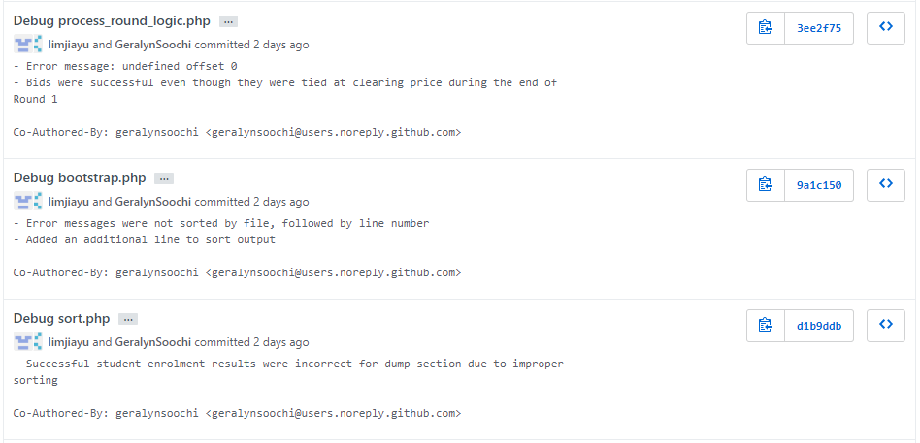
GIT HUB
CORRECT USAGE
Notes:
As you can see, there are clear and detailed descriptions attached with every commit pushed by each group member.

Slide 21
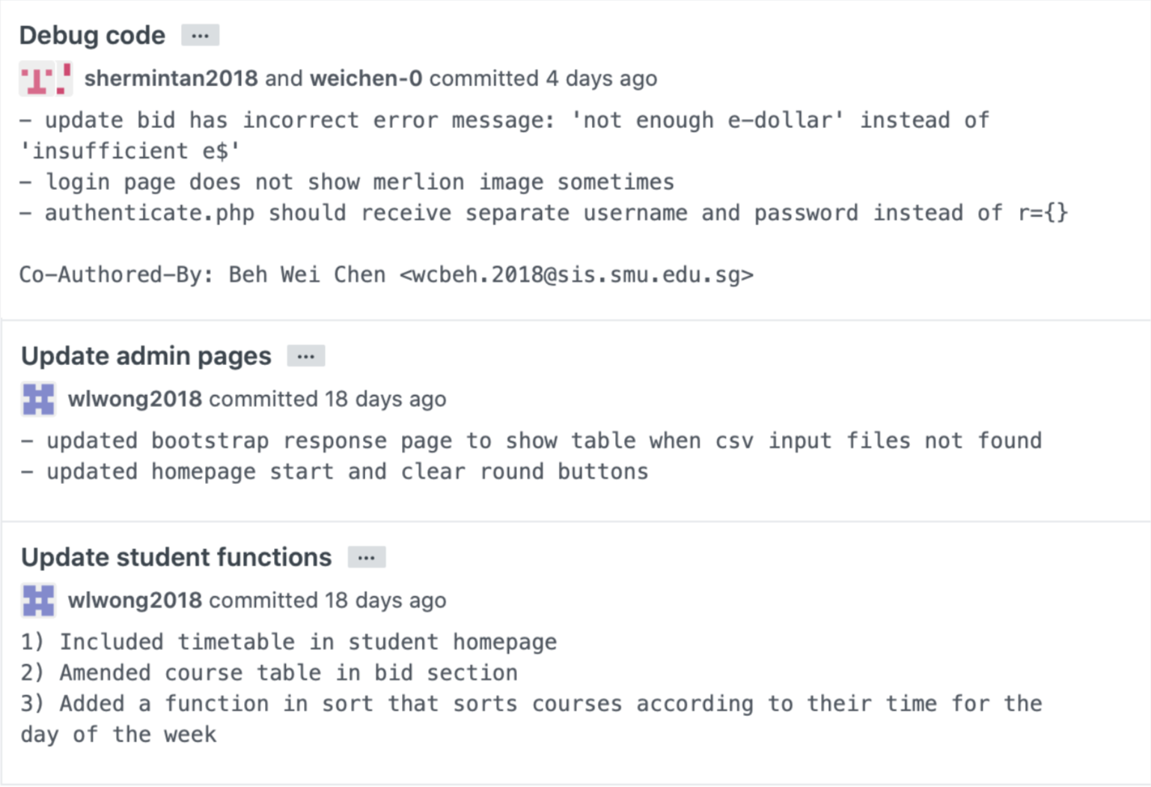
GIT HUB
CORRECT USAGE
Notes:
As you can see, there are clear and detailed descriptions attached with every commit pushed by each group member.

Slide 22
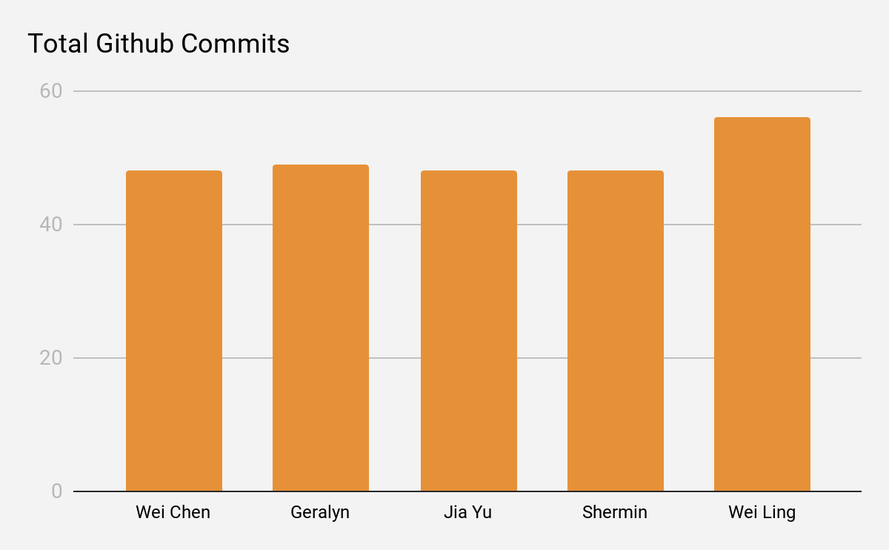
GIT HUB
EVEN USAGE
56
48
49
48
48

Slide 23
TAKEAWAYS
Notes:
Tell us what are the main takeaways you have gained from doing the project?
Any team conflicts/issues/problems and how your team resolved it. Be sensitive. This is not a finger pointing session.
Something particularly interesting about your team members that you did not know before SPM.

Slide 24

LEARNING POINTS
TAKEAWAYS
How to plan and manage a project properly
How to use Github properly
How to adapt to changes in client’s requirements
Importance of open communication
Prevents (merge) conflicts
Fosters teamwork
Importance of frequent (regression) testing
Importance of pair programming
Notes:
Tell us what are the main takeaways you have gained from doing the project?

Slide 25


LEARNING POINTS
PROBLEM
Merging of Repository Branches
Mistakenly pushed without pulling beforehand Branch merged but was reverted All codes pushed during last pp session lost
Assembled the group, got member who has yet to pull most recent update to copy code out and push again Members were reminded to always pull before pushing and pairs to double-check before pushing
Notes:
Any team conflicts/issues/problems and how your team resolved it. Be sensitive. This is not a finger pointing session.

Slide 26
LEARNING POINTS
PROBLEM
Members going inactive temporarily
Members have varying commitment peak periods Become less involved in the project and less contactable Portrays a lack of commitment, creating conflict within the team
Convened the group, ironed out conflicts and set basic expectations to be adhered Agreement to inform in advance, help each other out during respective peak periods and be more involved once the peak period ends
Notes:
Any team conflicts/issues/problems and how your team resolved it. Be sensitive. This is not a finger pointing session.

Slide 27
LEARNING POINTS
ABOUT MEMBERS
Wei Chen: Most likely his final year in SMU
Co-authored and published a storybook
Shermin: Coffee addict
Jia Yu: Avid lover of Buzzfeed Unsolved
Geralyn: Loves horror stories/movies
Wei Ling: Used to learn the electronic organ
Notes:
Something particularly interesting about your team members that you did not know before SPM.

Slide 28
THANK YOU

